Slide 1

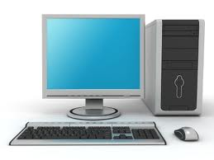
INTRODUCTION TO COMPUTING

Slide 2
Introduction to Computers
A computer is an electronic programmable device that can accept data as input, processes it according to instructions, output the information and store the results for future use.

Slide 3
Explanation of key terms
Electronic: A computer works in presence of electricity.
Programmable: A computer can work depending on the instructions installed in it.
Data: Raw facts & figures entered into a computer for processing.
Input: refers to data
Process. Turning raw facts into information.
Information: Refers to processed data
Storage: The process of keeping information for future use.

Slide 4
Characteristics of modern computers
High Speed: Computer can perform millions of instructions in a single second.
High level of Accuracy: Computers have the ability to perform a given task without mistakes. If right data is entered into the computer, right results are given out.. They work on a principle of GIGO.
Diligence: computers can work on the same task for a long period of time without getting tired, getting bored or losing concentration.

Slide 5
Characteristics of modern computers
Versatility: computers have the capability to perform completely different type of work at the same time (multitasking, multi programmable).
Memory: The Computer has an in-built memory where it stores large amount of data during processing
Automation and programmability: Computers receive and work on instruction on their own. They work on minimal human intervention.

Slide 6
Characteristics of modern computers
Large storage Capacity:
Computers are capable holding large amounts of data for long time without losing it through their storage media like; HDD, CDs, flash disks, DVDs, etc.
Artificial intelligence (AI):
Computers have the ability to mimic human thought. Programmed Computers can receive and respond to requests, and give the appropriate response.

Slide 7
Modes of acquiring computers
    Direct purchase of a computer
    Renting of a computer
    Hiring a computer
    Lease of a computer. -
    grant (property) on lease

Slide 8
Parts of the computer
A computer is composed of the following main parts.
      Monitor
      System case/ system unit
      Key board
      Mouse
      Speakers

Slide 9
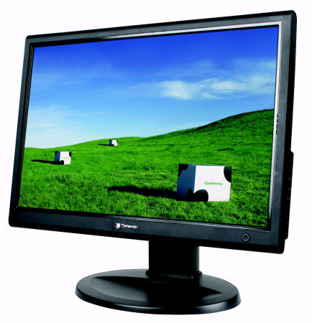

Functions of each part of the computer.
Monitor:
This is an output device used to display processed information in visual form using text, graphics and videos.

Slide 10
Functions of each part of the computer..
2. System case:
This is a rectangular box that stores many electronic internal components that process information for the computer.

Slide 11
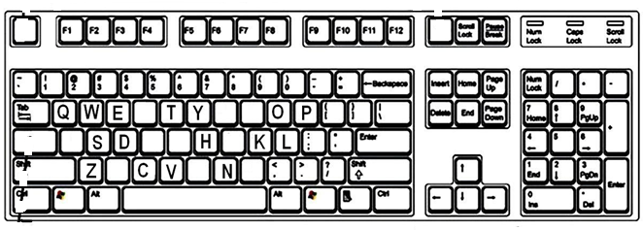
Functions of each part of the computer
3. Key board.
This is an input device used mainly for typing text into the computer.

Slide 12
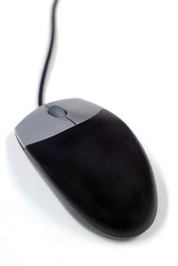
Functions of each part of the computer
4. Mouse:
This is an input device used to point and to select items on the computer screen.

Slide 13
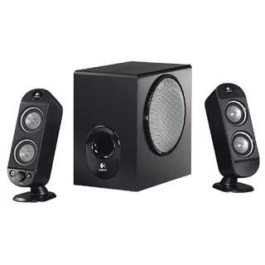
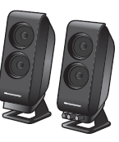
Functions of each part of the computer
5. Speakers:
These are output devices used to produce sound

Slide 14
Connecting various computer parts together.
If all the computer parts are disconnected, they can be connected together to form a computer system so as to accomplish a task as follows.
Connect a keyboard, mouse & a VGA cable from the monitor to the System unit.
Then connect the power cable of monitor to the power source & then that of the System unit.
Then boot the computer.

Slide 15
The computer system
A computer system is a group of interconnected parts working together to complete a given task.
Components of the computer system
    Hardware
    Software
    Human ware
    Communication
    Data

Slide 16
Hardware
This refers to the physical and tangible components of a computer.
Hardware comprises the electronic & the electromechanical parts of the computer.
Used to input data, process, store and output Information.

Slide 17
Categories of computer hardware
    Input hardware
    Processing hardware
    Storage hardware
    Output hardware
    Communications hardware
Examples of hardware devices
    Monitor keyboard,
    mouse,
    CPU
    Printer , Router etc

Slide 18
Software
This refers to the electronic instructions that tell the computer how to perform a task.
Software refers to the set of programs that control and manage the operations of the computer.
Categories of computer software:
  System software
  Application software

Slide 19
Examples of computer software
a) System software e.g.
  Operating system e.g. windows 8, Linux, DOS
  Utility programs e.g. Antivirus, Screen savers,
  Programming languages e.g. ADA, Pascal, FORTLAN
b) Application software e.g.
    Word processor
    Database
    Presentation software etc

Slide 20
3. Human ware
Human ware is also referred to as live ware or User
Human ware refers to the people who operate and initialize instructions to the computer
Human ware is the most important component of the computer system used to design and develop computer systems, operate the computer hardware, create the software, and establish procedures for carrying out tasks.
Notes:
this is the most important component of a computer system

Slide 21
Categories of human ware
        Ordinary user
        Professional user
1. Ordinary user
This is a person who uses a computer but without formal education in the technical use of computers.
2. Professional user
This a person in a profession involving computers who has had formal education in the technical aspects of computers e.g. a Computer programmer

Slide 22
Examples of computer Professional users
      Computer programmer
      System analyst
      System administrator
      Database administrator
      Network administrator.

Slide 23
Communication
This is the process of transferring data between computer systems or devices.
Categories
Communication through computer networks:
Internet 4. Intranets
LAN 5. WAN
MAN 6. PAN, etc.

Slide 24
Examples of networking devices
Cables / communication media
Modems
Routers
Gateways

Slide 25
Data & information
This refers to raw facts and figures that are entered into the computer for processing.
Categories of data
      Unproved data
      Information
Unprocessed data. These are the raw facts & figures which are meaningless to the final user.
Examples.
Letters & symbols. (e.g., a, b, c, &, ...), words Numbers/digits , Sound, Musical notes, graphics

Slide 26
Information.
This refers to processed data which conveys meaning to the final user.
E.g.
A document, 5. A mathematical formula,
A report card 6. A song
Dates 7. A Video,
A news paper

Slide 27
Qualities of good information
  It sh’ld be is complete
  It sh’ld be clear
  It sh’ld be relevant to its purpose
  It sh’ld be got in time
  It sh’ld be accurate

Slide 28
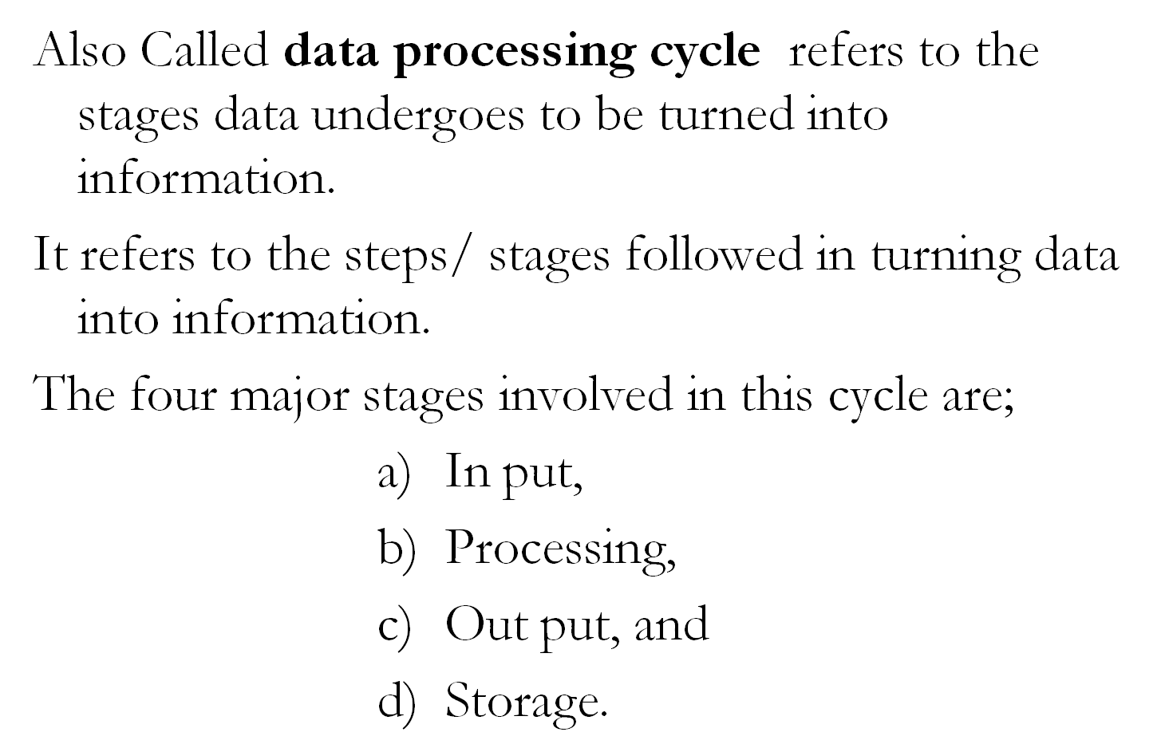
The Information processing cycle

Slide 29
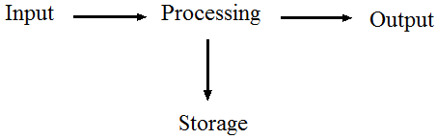
Stages involved in the Information processing cycle

Slide 30
Operations involved at each stage
At in put stage, data is collected and then entered in the computer using in put devices such as key board, scanner, and e.t.c.
At processing stage, the data is turned into information by the processor / CPU
At out put stage, processed data is displayed to the user using devices like the printer & monitors.
At storage stage, information is kept on a storage device e.g. flash disk, CD and other for future use or reference.
The information from the storage device can be fed into the system for further processing.

Slide 31
2. WORLD OF ICTs
ICT stands for Information and Communication Technology.
ICT is the combination of telecommunication technology such as satellite, internet, network hardware and software etc and computing technologies e.g. computers, cell phones, radios televisions etc to enhance communication.

Slide 32
Examples of old technologies before the coming of ICTS
    News papers
    Films
    Radios
    Paper printed photograph
    Television

Slide 33
Examples of new technologies after the coming of ICT
    Satellite
    e-mail
    video conferencing
    cellular phone
    Internet
    fax machines
    optical disks (CDS AND DVDS)
    Fibre optic cables

Slide 34
Why is ICT taught as a subject
To help learners develop & consolidate their knowledge of ICT & be aware of new & emerging technology
To encourage learners to develop as independent user.
To encourage learners to develop ICT skills to enhance work productivity in a variety of subject area
To empower learners and prepare them for lifelong learning.

Slide 35
Application of ICTs
ICT has been practically applied in various sectors ie;
    Homes, Business
    Education and training institutes
    Health
    Security
    Transport and communication
    Entertainment and leisure
    Industrial sector
    Computer modelling
    science

Slide 36
1. Application of ICT at home
At home, computers are used to / for;
Entertainment & leisure activities (playing online games)
To communicate with friends through emails & social sites.
Pay bills through payment by phone services
Budgeting and personal financial management
Buy and sell stocks online.

Slide 37
2. Application of computers in education
In schools, computers are used for based training which include;
Computer Assisted Instruction (CAI) where teachers use computers to present teaching materials in a more interesting way.
Computer Assisted Learning (CAL). Students can use computers & appropriate software to learn at their own pace.
Computer Assisted Assessment (CAA). Which may reduce time and labour to mark answer scripts.

Slide 38
Application of computers in education..
In education, computers are used for,
Distance learning through computer based training
Simulation for experiments or real life situations which may be hazardous.
Electronic library system for searching, borrowing and returning books
The school administration & management systems (SAMS) for keeping records of students and producing report cads or other related documents

Slide 39
Application of computers in education..
Making Error free school time tables can be made using special time table computer software.
Fees payment. ICT's such as mobile phones using mobile money can be used for paying school fees.
Examples of ICT tools used schools
Computers 4. Projectors
Printers 5. Photocopiers
Digital camera 6. Modems

Slide 40
Advantages of using it in teaching & learning
Teachers can present subject matter & explain difficult concepts more clearly with multimedia.
Teachers can demonstrate dangerous experiments through simulation software
Students learn by themselves when the teacher is absent
Students can get their results & feedback immediately after they have answered qn.
CAI & CAL packages that contain multimedia packages make learning more interesting & interactive.

Slide 41
Disadvantages of using it in teaching & learning
Face to face interactions between students & teachers may be reduced.
Students can only follow what CAL packages are designed to offer
In absence of electricity teaching & learning cannot take place.

Slide 42
3. Application of it in offices
In offices, computers are used for / to;
Create memos, letters & reports.
Calculate payroll, prepare income statements & balance sheets
Track inventory & generate invoices and receipts.
Present projects & ideas by means of presentation software
Use facsimile, e-mail, electronic bulletin & video conferences.
Create websites to provide information, advertise products & services and conduct e-commerce

Slide 43
4. Application of ICT in banks
Automatic teller machine (ATM): This is a self service machine attached to a host computer through telephone network used for online business activities.
Services available through ATM
  Withdraw cash
  Deposit cash
  Check for account balances
  Online banking
  Transfer money between different accounts
  Download monthly transaction information etc

Slide 44
Electronic commerce
This is a financial business transaction that occurs over a network (internet). E.g. Online shopping and banking.
E- money is a mean of paying for a good and service over the internet.
A set of standards that control the transfer of business data & information among computers both within and among companies is called Electronic Data Interchange (EDI).

Slide 45
Models of e- commerce
Business to consumer (B2C): This is a business transaction that occur over the internet where a business sells goods to general public.
Consumer to consumer (C2C): This is…. where one consumer sells directly to another consumer.
Business to business (B2B): This is….. where a business provides services & goods to another business

Slide 46
Advantages of e-commerce
Transactions can occur immediately & globally thus saves time for participants on both ends
Transactions can occur 24 hrs per day
Information can be changed and be availed quickly.
Consumers can compare prices easily.
Manufactures can sell directly to consumers hence eliminating middlemen and their effects

Slide 47
Application of IT in leisure & entertainment
In leisure and entertainment, computers are used to;
    Play computer games
    Listen to music
    Watch a movie
    Compose and edit a video
    Read a book or a magazine online
    Plan a vacation

Slide 48
Application of ICT in industries
Computer Aided Design: used for creating engineering, architectural & scientific drawings.
Computer aided manufacturing: to manufacture 3-D objects
Robotics. A robot is a computer-controlled device that can move & react to feedback from out side world.
Robots are used for jobs that require;
    Repetitive tasks
    Lifting heavy equipments
    High degree of precision
Notes:
Popular cad software include; Autodesk, AutoCAD & Microsoft visio techinical

Slide 49
Application of ICT in health sector
In hospitals, computers are used for/ to;
Scanning operations
Drug mixing & prescription
Keep patient records
Monitor patients’ vital signs
Carrying out Computer- assisted medical tests

Slide 50
Application of ICT in health sector
Carrying out sensitive operations on sensitive body parts like the brain, heat & kidney.
Research and diagnose medical conditions
Implant computerized devices e.g. (pacemakers) that allow the patient to live longer.
Use computer-controlled devices during operations that require great precision e.g. laser eye surgery & heart surgery).

Slide 51
Implication of using ICT
Advantages
Increased access and sharing of databases within and outside the organization through networking.
Increased interactions and collaborations through e mails, chart rooms, videoconferencing etc
Improved access to education through videoconferencing, internet use of simulations and animations

Slide 52
Implication of using ICT
Advantages
Creation of jobs such as mobile money service provision, ICT technicians.
Increased access to shared information which in turn simplifies research.
Increased inventions and innovations such as the wireless key board, mouse, touch screens
Increased efficiency and effectiveness leading to increased productivity hence less wastage of resources.

Slide 53
Implication of using ICT
Disadvantages
Widens the gap between information rich and poor. (Digital divide)
Isolates the old people since they do not find it easy to lean and use the ICT gadgets very fast.
Reduced physical activity
Erosion of individual privacy
Un employment
Addiction to computers

Slide 54
Implication of using ICT
Disadvantages
Increased computer crimes such as hacking, phishing, software piracy etc.
They are both health & environmental hazards i.e. cause eye defects.
Nb. The environmental impact of computers can be mitigated by carrying out Green Computing

Slide 55
Green computing
This refers to the use of computers in a way which has less negative impact on the environment.
It is the use of computers in an environmentally friendly way.
The goals of green computing.
  To reduce the use of dangerous materials
  To maximize energy efficiency during the product’s life time
  To promote the recyclability / biodegradability of outdated products & factory wastes.

Slide 56
Ways through which Green computing can be practiced
Use LCD monitors, instead of cathode ray tube (CRT) monitors.
Use the hibernate or sleep mode when away from a computer for extended periods
Buy energy efficient notebook computers, instead of desktop computers.
Activate the power management features for controlling energy consumption
Dispose off electronic wastes properly.

Slide 57
Ways through which Green computing can be practiced …
Turn off computers at the end of each day
Refill printer cartridges, rather than buying new ones.
Instead of purchasing a new computer, try repairing existing device.
Dispose of e-waste according to federal, state and local regulations.
Power-up and power-down energy-intensive peripherals such as laser printers according to need.

Slide 58
Revision questions
What is a computer?
b) Explain the characteristics of modern computers
2. Describe how the various parts of the computer can be connected to form a system
b) What is a computer system?
c) Outline the components of the computer system & write short notes on each component

Slide 59
Revision questions.
Distinguish between data & information
b) What do you understand by the information processing cycle?
c) Describe the steps involved in the information processing cycle.
d) Outline the qualities of information.
4. What is ICT?
b) Outline the examples of ICTs commonly used today.

Slide 60
Revision questions
5. Explain how ICT is used in the following sectors
    Banks d) Hospitals
    School
    Entertainment etc
b) Give the positive & negative impacts of ICT on society
6. What is green computing?
b) Outline the various ways by which green computing can be practiced.

